Slide 1
Comparing Two Groups
Jamil Bhanji
with help from Vanessa LoBue
and Andy Field

Slide 2
Aims
t-tests
Dependent (paired-samples, matched-pairs)
Independent
Rationale for the tests
Nonparametric Tests

Slide 3
Experiments
The simplest form of an experiment is with only one independent variable that is manipulated to yield only two levels and only one (continuous) outcome is measured.
E.g., experimental condition vs. control, one outcome measure
This situation can be analysed with a t-test

Slide 4
T-test
Independent t-test
Compares two means based on independent data
E.g., data from different groups of people
Dependent t-test
Compares two means based on related data.
E.g., Same people measured at different times.
Data from ‘matched’ samples.

Slide 5
Rational for the t-test
Two samples are collected and the means calculated
These means might differ by either a little or a lot
If the samples come from the same population (this is the null hypothesis), we would expect large differences between sample means to occur very infrequently.

Slide 6
Rational for the t-test
If the difference between the samples is larger than we would expect based on the standard error then one of two things has happened:
1. There is no true effect but sample means from our population fluctuate we happen to have collected two samples that produce very different means
2. The two samples come from different populations. In other words, the null hypothesis is unlikely
Notes:
The larger the observed difference between the sample means (relative to the standard error), the more likely it is that the two sample means differ because of the different testing conditions imposed on each sample.

Slide 7
Assumptions of the t-test
Both the independent t-test and the dependent t-test are parametric tests based on the normal distribution
Therefore, they assume:
The sampling distribution is normally distributed
In the dependent t­-test this means that the sampling distribution of the differences between scores should be normal, not the scores themselves
The outcome is measured at least at the interval level. For ordinal data, see “Non-parametric tests”

Slide 8
Assumptions of the t-test
The independent t-test, because it is used to test different groups of people, also assumes:
Variances in these populations are roughly equal (homogeneity of variance).
Scores in different treatment conditions are independent (because they come from different people).

Slide 9
Non-Parametric Tests
Mann-Whitney/Wilcoxon rank-sum Test
Compares two independent groups of scores
Wilcoxon signed rank Test
Compares two dependent groups of scores
Notes:
When data violate the assumptions of parametric tests we can sometimes find a nonparametric equivalent

Slide 10
Ranking Data
Non-parametric tests work on the principle of ranking the data for each group:
Lowest score = a rank of 1,
Next highest score = a rank of 2, and so on.
Tied ranks are given the same rank
The analysis is carried out on the ranks rather than the actual data.

Slide 11
Effect size
The “strength” of an effect
How different are two means?
How closely associated are two variables?
How much outcome variance do(es) the predictor(s) explain?
Not dependent on sample size
t-stat, F-stat, X², W, U are not effect sizes
Mean difference, covariance, (unstandardized) regression beta coefficients are unstandardized effect size measures
Cohen d, r, 𝜌, r², η², Cohen f, Hedge’s g, Glass’s Δ are common standardized effect size measures

Slide 12
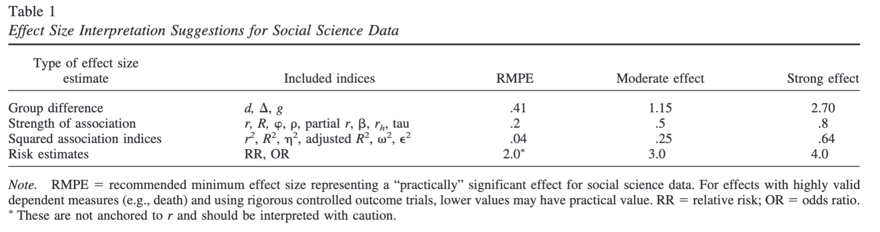
Effect sizes (Ferguson)

Slide 13
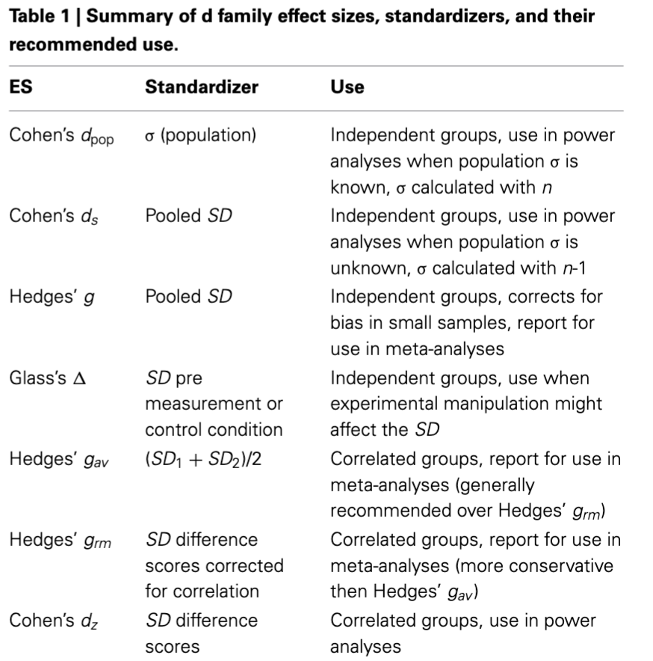
Effect sizes (Lakens)

